Slide 1
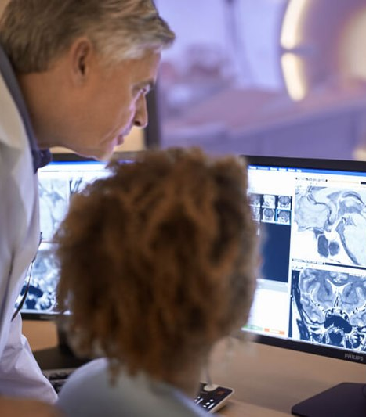

www.acoredu.com

Slide 2


Richard Fagan, MD
Baylor College of Medicine

Slide 3

WHAT’S NEW IN:
GI Imaging
Reviewed By:
Senior editor 1
Senior editor 2
etc

Slide 4
Colonoscopy versus catheter angiography for lower gastrointestinal bleeding after localization on CT angiography.
Tse JR, Felker ER, Et al. J Am Coll Radiol. 2022; 513-520
Compares outcomes of catheter angiography (CA) vs colonoscopy after CTA localization
CA group showed higher confirmation yield
Therapeutic yield not significantly different
CA significantly faster, 10 hours on average
Adverse events including renal injury and rebleed not significantly different

Slide 5
Detection of high-risk sessile lesions: Multitarget stool DNA versus CT colonography.
Deiss-Yehiely N, Graffy PM, et al. Am Jour Roent. 2022;218:670-677
Compared multitarget stool DNA (mt-sDNA) vs CT colonography to detect high risk sessile serrated lesions (SSLs)
Positive result: mt-sDNA (13.1%), CT colonography 6-mm (12.2%), 10-mm (6.5%)
PPV: mt-sDNA (5.5%), CT colonography 6-mm (14.4%), 10-mm (25.9%)
High risk SSL yield: mt-sDNA (0.7%), CT colonography 6-mm (1.7%), 10-mm (1.6%)

Slide 6
Saline-aided ultrasound versus upper GI series in neonates and infants with suspected upper GI obstruction: a prospective multicenter comparative study.
Chen S, Chen D, et al. Am Jour Roent 2022;218:526-533
Diagnostic performance of saline-aided US vs UGI series for presence, level and cause of UGI obstruction
Presence of obstruction
  US: Accuracy* (94.7%), SN (98.4%), SP (89.4%)
  UGI series: Accuracy* (89.5%), SN (95.2%), SP (81.2%)
Level of obstruction
  US: Accuracy (90.3%), SN (97.2%), SP (56.3%)
  UGI series: Accuracy (87.1%), SN (92.6%), SP (50.0%)
Favorable comparison with reduced radiation exposure

Slide 7
Discriminating rectal cancer grades using restriction spectrum imaging.
Xiong Z, Geng Z, et al. Abdominal Radiology 2022; 47:2014-2022
RSI is novel DWI technique that separates diffusion into 3 compartments, giving more tissue specific detail
Authors compared RSI with standard DKI and ADC parameters on DWI
Restricted compartment on RSI significantly correlated with tumor grade with AUC 0.753
RSI significantly outperformed DKI and ADC

Slide 8
Bowel peristalsis artifact on dual-energy CT: In vitro study on influence of different dual-energy CT platforms and enteric contrast agents.
Obmann M, Sun Y, et al. Am Jour Roent. 2022; 218:290-299
Bowel wall peristalsis introduces artifact, limiting assessment
Four DECT platforms and multiple enteric contrasts tested in vitro
120-kVp like images: lower artifact for split-filter and dual-source than spectral-detector and rapid kilovoltage-switching scanners
120-kVp images: lower artifact for spectral-detector and rapid-kilovoltage-switching scanners
Less artifact with experimental dark contrast than air, water or iodinated contrast

Slide 9




@ACOREdu
@ACOREdu
@ACOREdu
www.acoredu.com
Notes:
For more details, you can read our blog where you can find links to the original publications.
Please feel free to share your thoughts and questions with us on the (specialty) forum. and see you next month.

