Slide 1
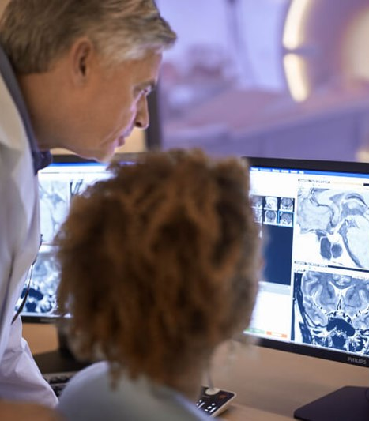

www.acoredu.com

Slide 2

Dane Eskildsen DO
Baylor College of Medicine

Slide 3

WHAT’S NEW IN:
Gastrointestinal Imaging
Reviewed By:
Vincent Mellnick, Senior Editor
Alice Fung, Senior Editor
Dane Eskildsen DO, Junior Editor
Richard Fagan MD, Junior Editor

Slide 4
Is the Mixed Use of Magnetic Resonance Enterography and Computed Tomography Enterography Adequate for Routine Periodic Follow-Up of Bowel Inflammation in Patients with Crohn's Disease?
Ha J, Park SH, Son JH, et al. Is the Mixed Use of Magnetic Resonance Enterography and Computed Tomography Enterography Adequate for Routine Periodic Follow-Up of Bowel Inflammation in Patients with Crohn's Disease?. Korean J Radiol. 2022;23(1):30-41.
CTE and MRE is used for follow up of Chron's disease (CD)
Can you mix them?
CD patients with previous CTE and MRE or MRE alone selected
CD inflammation: Unchanged, decreased, increased.
MRE alone superior to mixed use of CTE/MRE

Slide 5
The impact of social distancing during the COVID-19 pandemic on rates of pediatric idiopathic intussusception
Handa, A., Callahan, M.J., Kawai, K. et al. The impact of social distancing during the COVID-19 pandemic on rates of pediatric idiopathic intussusception. Pediatr Radiol 52, 453–459 (2022).
Infection linked to ileocolic intussusception
Social distancing during COVID pandemic -> decreased infection transmission
Does this correlate with a decrease in intussusception?
Evaluated rates of intussusception and HPS (neg control) pre pandemic vs. During pandemic
72% decrease in rates of ileocolic intussusception. No change in HPS.

Slide 6
Resurgence of intestinal ascariasis among adults: radiological diagnosis and clinical implications
Ghahremani, G.G., Hahn, M.E. Resurgence of intestinal ascariasis among adults: radiological diagnosis and clinical implications. Abdom Radiol 47, 915–922 (2022).
Ascariasis has had a resurgence in the US in recent years
12 patients with ascariasis on imaging
CT/Small bowel series: Tubular filling defect
MR enterography: hypointense worms within bowel lumen
Worms ingest contrast --> Intestinal tract opacification
CT/small bowel series preferred over MR enterography

Slide 7
Comparison of MRI appendix biometrics in children with and without acute appendicitis
Tung, E.L., Baird, G.L., Ayyala, R.S. et al. Comparison of MRI appendix biometrics in children with and without acute appendicitis. Eur Radiol 32, 1024–1033 (2022).
MRI comparable to CT for appendicitis, but rarely used.
No MRI specific diagnostic criteria
Biometric values for appendicitis vs without appendicitis:
Wall thickness - 2.6 mm vs 1.7 mm, Diameter - 10.4 mm vs. 5.8 mm
Qualitative biometrics - peri-appendiceal fatty edema, ability to distinguish wall intensity from lumen intensity were found to be the best indicators for positive cases of appendicitis on MRI

Slide 8
Evaluating suspected small bowel obstruction with the water-soluble contrast challenge
Lawrence EM, Pickhardt PJ. Evaluating suspected small bowel obstruction with the water-soluble contrast challenge. Br J Radiol 2021; 95: 20210791.
Water soluble challenge (WSC) can determine need for surgery in SBO
What is it? Give contrast --> Evaluate transit after 24 hours
No transit to colon = failed. Transit to colon = passed
Possible therapeutic value
Use of WSC challenge in special populations
Possibility of CT based WSC challenge

Slide 9




@ACOREdu
@ACOREdu
@ACOREdu
www.acoredu.com

